Slide 1
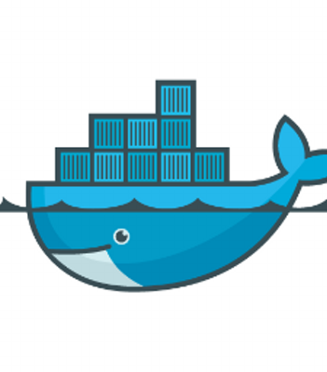
Containers & Microservices, Docker
Hussaina Begum N.

Slide 2
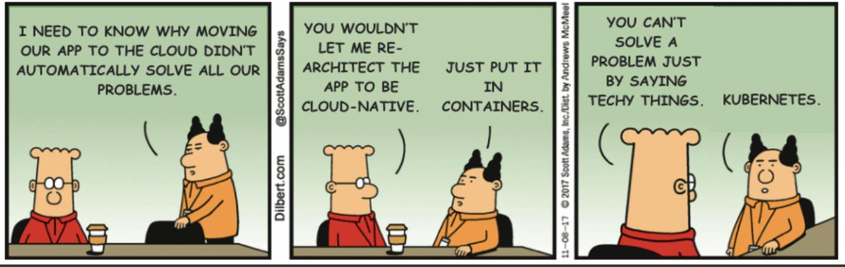
Why this session?
@scottadamssays

Slide 3
Agenda
History
Linux Containers(LXC)
Microservices architecture
What are Dockers ?
Docker Architecture
Docker Hands-On
Dockerfile example
Docker networking
Kubernetes
Q&A

Slide 4
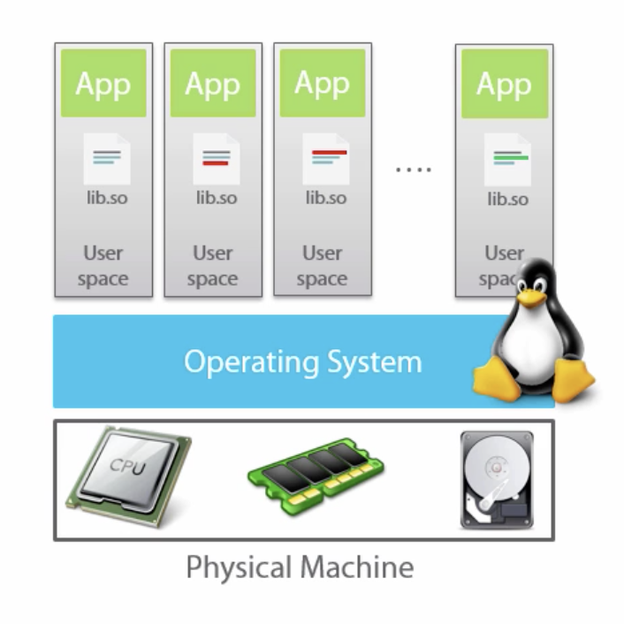
Long time ago in a galaxy far far away …
Physical servers
Monolithic applications
Scaling is hard and expensive
@nigelpoulton

Slide 5
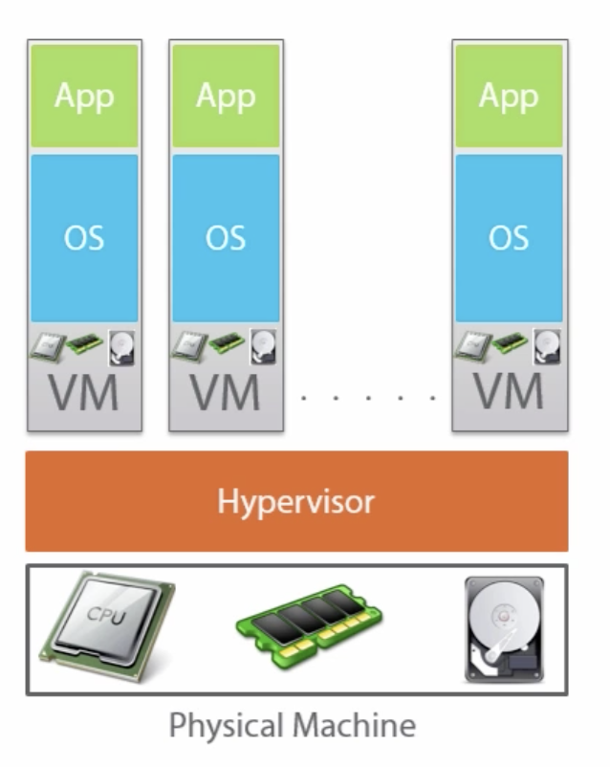
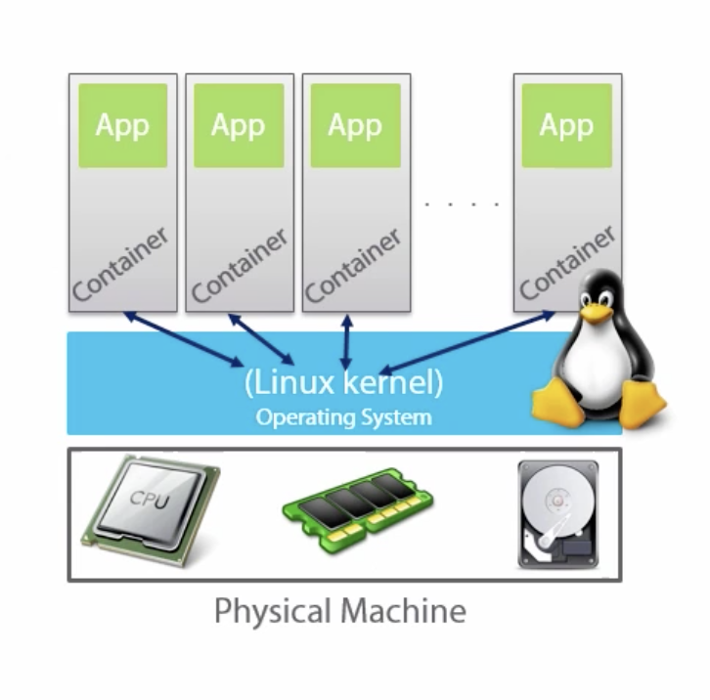
History
VMs vs. containers
@nigelpoulton

Slide 6
Linux Containers (LXC)
Something in between chroot and VM
Uses the below constructs to achieve containers
Kernel namespaces (ipc, uts, mount, pid, network and user)
Apparmor and SELinux profiles
Seccomp policies
Chroots (using pivot_root)
Kernel capabilities
Cgroups (control groups)
Notes:
sudo cat /proc/sys/kernel/cap_last_cap
sudo capsh –print
getpcaps <pid>
$ getpcaps 1549
Capabilities for `1549': = cap_dac_override,cap_net_bind_service,cap_net_admin,cap_net_raw,cap_sys_module+ep
$ps -o cgroup 1549
CGROUP
10:blkio:/system.slice/ifup@ens160.service,9:pids:/system.slice/ifup@ens160.service,7:memory:/system.slice/ifup@ens160.service,4:devices:/system.slice/ifup@ens160.service,2:cpu,cpuacct:/system.slice/ifstem
$ sudo apparmor_status
$ cat /etc/apparmor.d/usr.sbin.sssd

Slide 7
Linux Containers (LXC) ➔ Docker
LXC + aufs → dotCloud (dc)
Changes to LXC broke dc
dc came up with libcontainer abstraction
dc -> docker daemon
docker daemon is bloated(monolith)
Open Container Initiative (runtime spec, image spec)
docker refactoring

Slide 8
Microservices Architecture
Monolithic applications are
Inflexible
Unscalable
Unreliable
Slow development(same framework for all components)
Microservices
Small autonomous services
Independent and loosely coupled components
Can scale each component
Stateless components
Redeployment
Small focused, loosely coupled, language independent, bounded context
https://blog.newrelic.com/technology/microservices-what-they-are-why-to-use-them/
Notes:
https://blog.newrelic.com/technology/microservices-what-they-are-why-to-use-them/

Slide 9
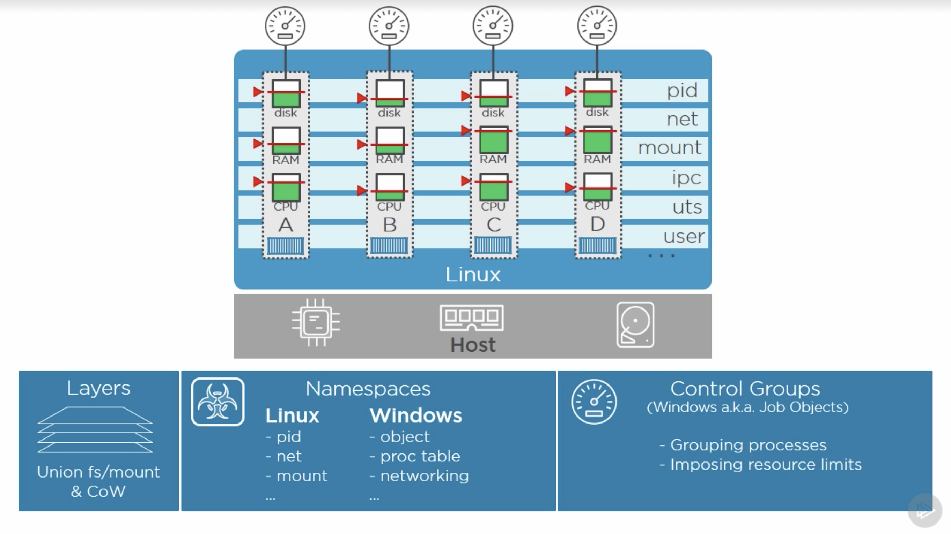
Dockers
OS level virtualization
Shares host kernel
Multi-layered FS
Union FS(overlay2), mount, CoW
Namespaces
pid, net, mnt, ipc, uts, user
Cgroups
Grouping procs, rlimits
@nigelpoulton
Notes:
Image from @nigelpoulton

Slide 10
Docker on Windows/Mac
Docker Toolbox (not a native solution)
Virtual Env, boot2docker, Docker Engine, Docker Machine, Docker compose
Network, storage is not shared from host
Mac Native Docker (2016)
HW virtualization, Embedded Linux, unikernel, docker engine
Windows Native Docker(2016)
Windows Server based
Leverages namespace, cgroup of windows kernel
Host kernel is shared
Hyper-V based
Containers run in highly optimized VM
Host kernel is not shared
Notes:
OSX - hyperkit
docker-machine create --driver virtualbox default
docker-machine ls

Slide 11
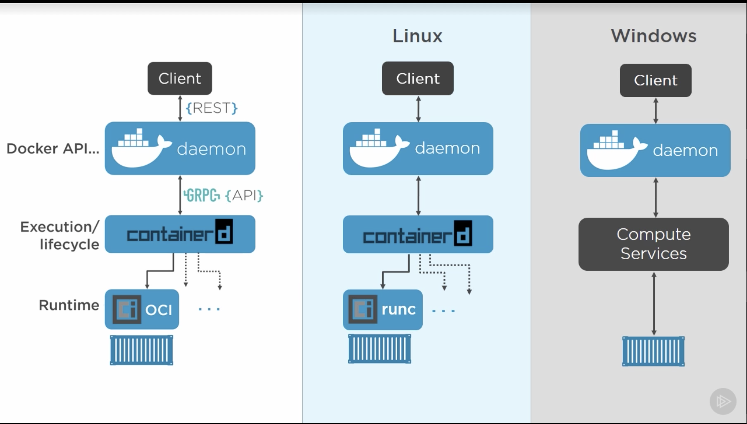
Docker Engine
API server
Docker daemon
containerd
Runtime
runc
Rkt – retired
Cri-o (for k8s)
@nigelpoulton
Notes:
dockerd
Listen to API requests
Manages container life cycle
/var/run/docker.sock
containerd
Image pull/push
Storage mgmt(image, snapshot, diff)
Exec containers by calling runc
Network mgmt.
Full OCI support
runc
https://github.com/opencontainers/runc
https://cri-o.io
docker, docker-containerd, docker-containerd-shim, and docker-runc.
sudo docker info|grep -i runtime
docker run -d alpine sleep 60
ps fxa | grep docker -A 3

Slide 12
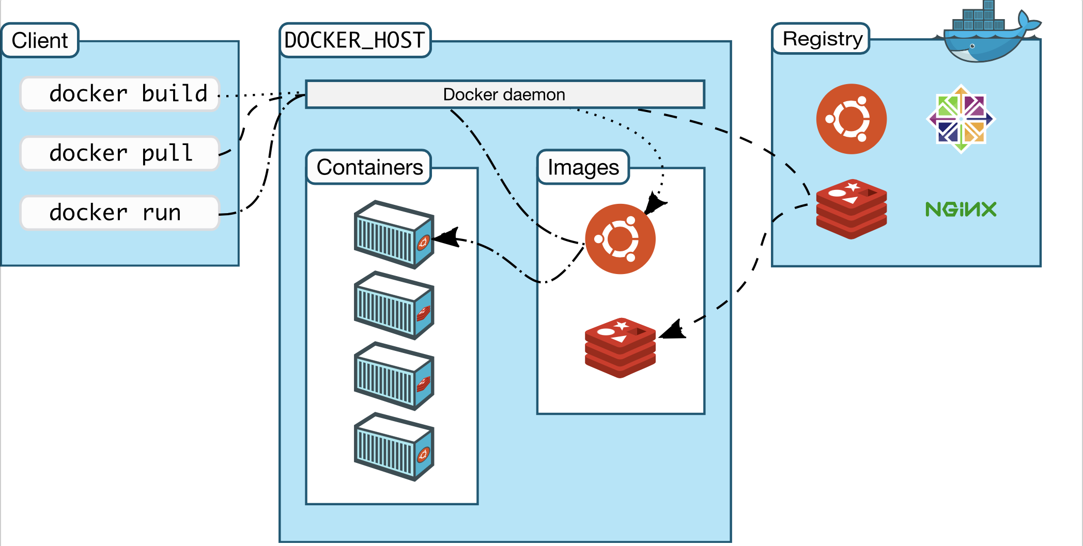
Docker workflow
Image
Container
Registry
Image @docker.com
Notes:
Image – A template RO filesystem(layered), which will be shared across containers
Container – secure and isolated container created from an image, which can run/start/stop/move/delete’d
Registry – Secure repository of images

Slide 13
Dockers – Install/HandsOn
Docker install on Ubuntu/Mac/Windows
docker info – lists the docker engine details on the host(client and server versions)
docker pull <image> – pulls image to docker host
docker run – starts a new container
docker stop – stops the container
docker ps – lists current running containers
docker images – lists the images on docker host
docker rmi – removes image from docker host
Notes:
24 vim /etc/apt/sources.list
25 apt update
26 sudo apt-get remove docker docker-engine docker.io
27 sudo apt install docker.io
28 sudo systemctl enable docker
29 docker --version
30 docker ps
31 docker info
$ sudo apt-get remove docker docker-engine docker.io
$ curl -fsSL get.docker.com -o get-docker.sh
$ sudo sh get-docker.sh
$ sudo usermod -aG docker <your-user>
$ docker –version
$ docker run hello-world
$ docker run --detach --publish=80:80 --name=webserver nginx #access http://localhost/

Slide 14
Dockerfile
CAPITALIZED instructions
<INSTRUCTION> - <value>
FROM
RUN
COPY
ENTRYPOINT
CMD
Notes:
docker build -t image .
=========
FROM alpine
LABEL maintainer "hnandyala@vmware.com"
RUN apk add --update python
COPY . /src
WORKDIR /src
ENTRYPOINT ["python", "./hello-world.py"]
CMD ["NSBU"]
======
$ cat hello-world.py
import sys
arguments = len(sys.argv)
if (arguments <= 1):
print('Hello, world!')
else:
print('Hello, %s!' % (sys.argv[1]))

Slide 15
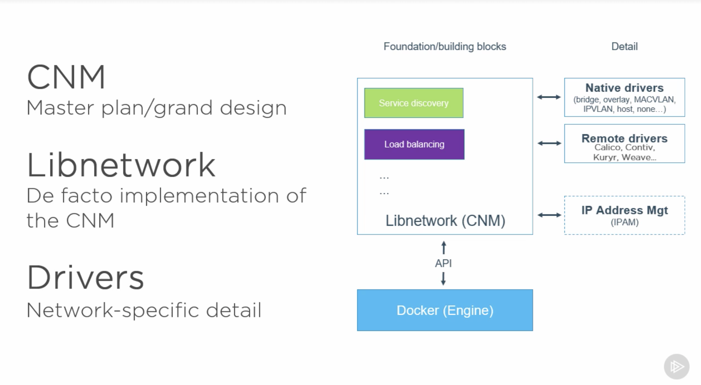
Dockers – Networking
CNM
Sandbox – namespaces
Endpoint - interfaces
Network – connected endpoints
Libnetwork
Drivers
host
bridge
none
Remote(overlay, macvlan)
@nigelpoulton
Notes:
Alternative - https://github.com/containernetworking/cni

Slide 16
Dockers – Networking
docker network ls
docker info
docker network create
docker network connect
docker network disconnect
Demo of single host networking
Notes:
$ docker run -dit --name alpine1 alpine ash
$ docker run -dit --name alpine2 alpine ash
$ docker container ls
$ docker network inspect bridge
$ docker attach alpine1
# ip addr show
# ping -c 2 google.com
# ping -c 2 172.17.0.3
# ping -c 2 alpine2
CTRL + p CTRL + q
$ docker container stop alpine1 alpine2
$ docker container rm alpine1 alpine2

Slide 17
Dockers – Orchestration
docker compose(single host)
-link command
docker swarm (multi-host)
swarm init
swarm join
kubernetes

Slide 18
References
https://docs.docker.com
https://success.docker.com/article/networking
Pluralsight courses
https://app.pluralsight.com/profile/author/nigel-poulton
Docker Deep Dive
Docker Networking
Linux Foundation courses
Container Fundamentals (LFS253) - https://vmware.sabacloud.com/Saba/Web_spf/NA1PRD0121/common/ledetail/cours000000000035007
Kubernetes Fundamentals - https://vmware.sabacloud.com/Saba/Web_spf/NA1PRD0121/common/ledetail/cours000000000035010

Slide 19
Thank you!!
Questions ?

Slide 20
Backup
Project Pacific
NSX container plugin(NCP)
Project Tanzu/Antrea

